Slide 1

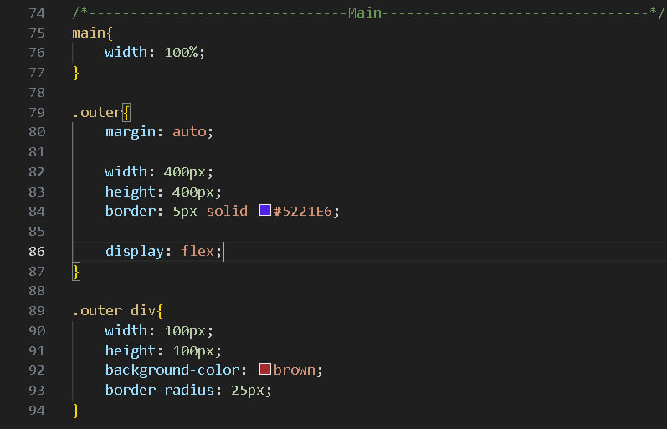
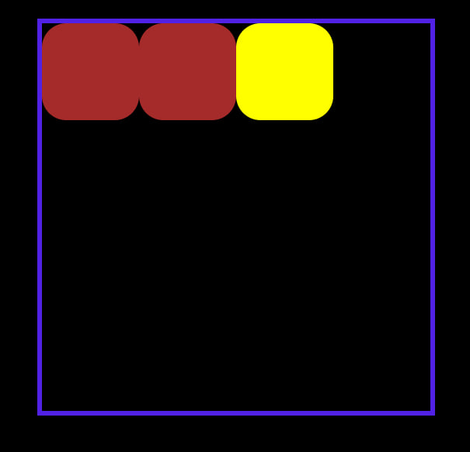

Slide 2


1 и 2

Slide 3
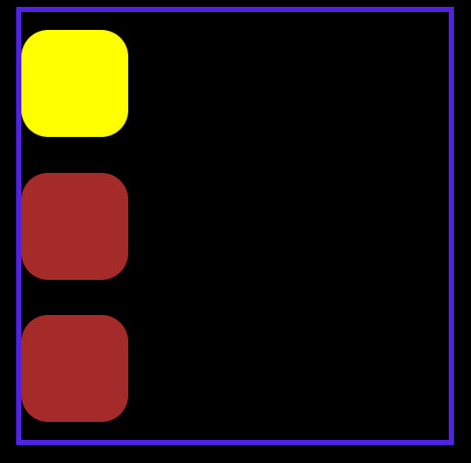

3 и 4

Slide 4
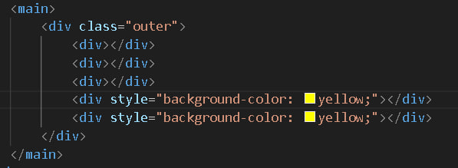

Slide 5

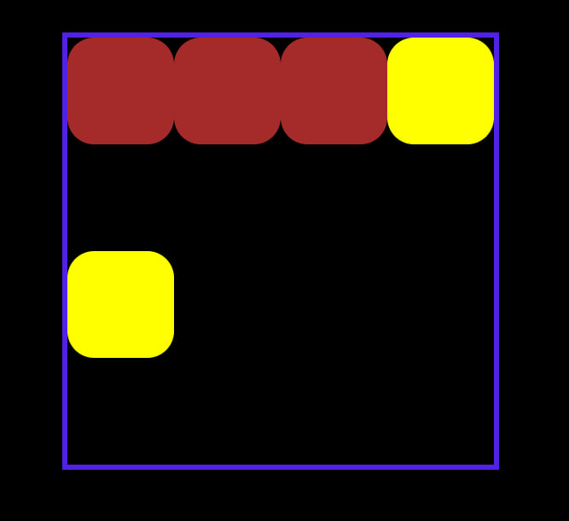
5 и 6

Slide 6
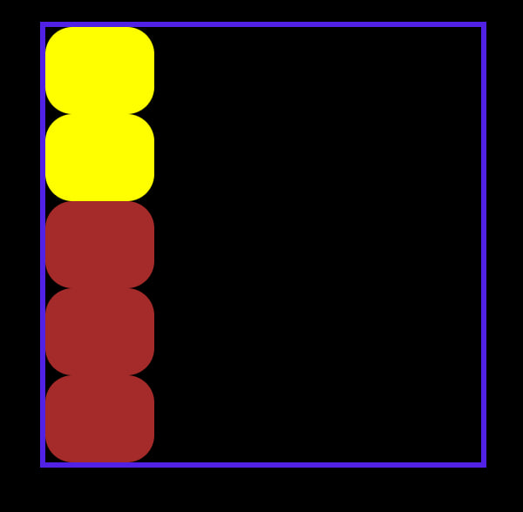
7

Slide 7
Верстаем frame 10 (Philosophy & values) и frame 32 (Dribbble)

